Slide 1
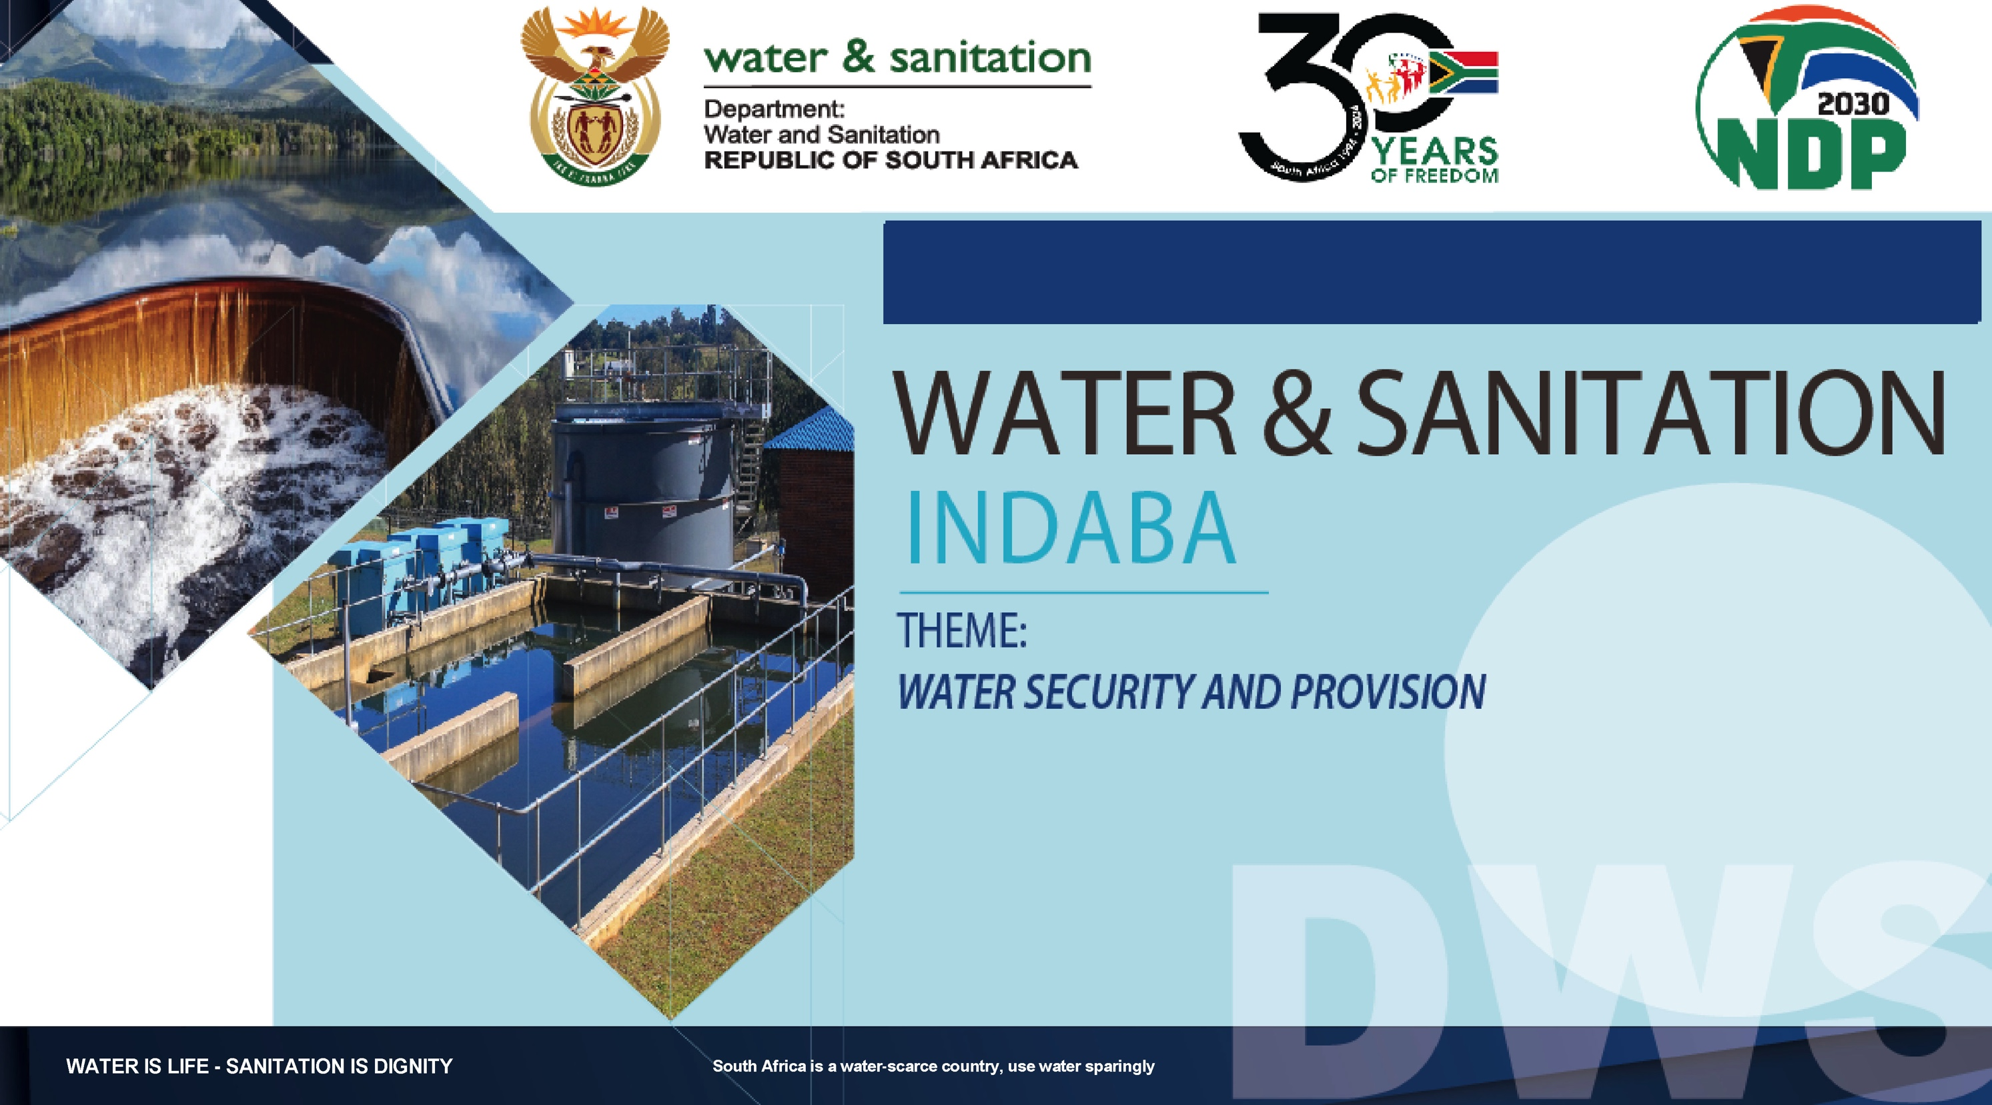
27-28 March 2025 | Gallagher Convention Centre
Status of water resources and interventions to match water supply to water availability
Facilitated by: Mr Percy Sechemane (CE TCTA)
Presented by: Mr Livhuwani Mabuda
March 2025

Slide 2
Agenda for Group 1 work
Presentation on raw water security to group by DWS and expert
Discussion on presentations
  Does the DWS presentation identify the key actions required to ensure raw water security?
  What other actions should be taken?
  What are the reasons for a lack of progress in implementation of the required actions?
  What needs to be done differently to make more progress with implementation of the required actions?

Slide 3
Agenda for Group 1 work: Five Pillars of Focus
Pillars | Action | Responsibility | Timeframe
An Implementation and Delivery Model
Financial Viability of the Water and Sanitation Sector
Technical and Operational Capacity
Efficiency of the System

Slide 4
1. NATIONAL STATUS OF RAW WATER
Raw water supply is currently approximately in balance with existing demands on a national scale, but there are localized deficits, e.g.
  Nelson Mandela Bay (2015-2023) and Cape Town (2016-2018) deficits caused by droughts
  Gauteng (current) caused by increased demand and delay in LHWP2
Water availability in South Africa could deteriorate rapidly as supply contracts and demand escalates due to economic growth, population growth, urbanization, inefficient use (including increasing physical losses in municipal distribution systems), degradation of wetlands, impacts of climate change
Delays in the implementation of surface water resource development projects affects water availability. However, substantive progress has been made in unlocking blockages
Broadening of South Africa’s water resource mix is critical for water security as potential to further develop its surface water resources is limited – already harnessing approximately 75% of utilizable surface water resources
Need to increase sustainable use of groundwater; desalination of sea water; return flows from treated waste-water systems (water re-use); reuse of other poor-quality water such as acid mine drainage – many of these are local functions
Supply-side measures necessary but not sufficient to avoid future water deficits - water conservation and water demand management (WCWDM) must also be implemented, particularly in domestic and general industrial use, by reducing physical losses in municipal distribution systems

Slide 5
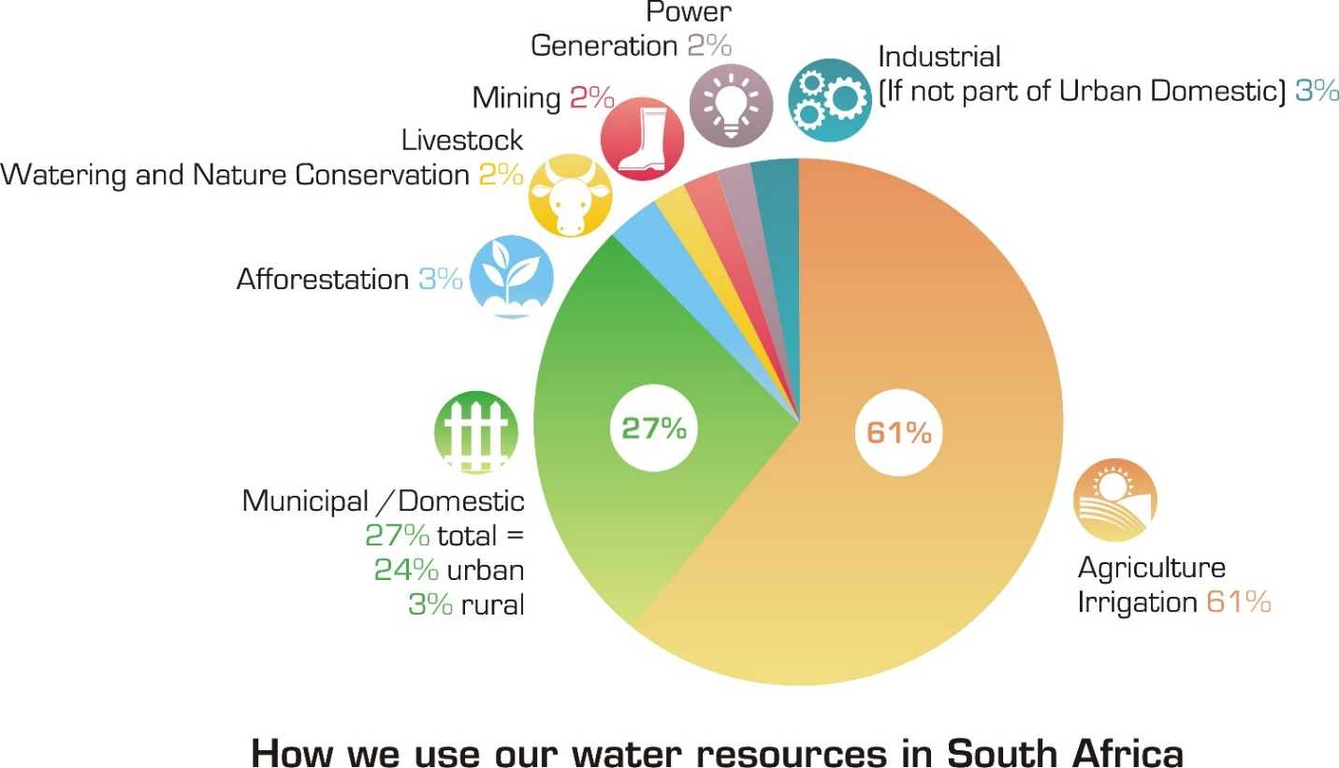
2. Water use by sector
2017

Slide 6
2. Water use by sector
2025
The data suggestions a shift in water use per sector. Proportion of water used in agriculture has reduced by 6% from 61% to 55% and the proportion used by municipalities has increased.

Slide 7
3. Water Balances for Large National Water Supply Systems
The map shows that some of the large water supply systems are near balance or that there are localized deficits
IVRS has a large deficit due to the increase in demand and delay in completion of LHWP2
The 2050 balances reflect impact of implementation of interventions like surface water development projects, groundwater schemes, desalination, effluent reuse
In stressed catchments like Luvuvhu-Letaba, water reallocation through compulsory licensing will be implemented

Slide 8
4. Need to diversify the water resource mix and implement water demand management
The remaining surface water resources development potential is limited
Groundwater resources are sparsely located and therefore suitable for local development
There is need to diversify water resources to include non-conventional resources like water reuse and seawater desalination
Water availability is also strengthened by sharing water with co-basin states
The real losses nationally are estimated at 1.0 billion m³/year and this can be returned to the various systems through aggressive water conservation and water demand management

Slide 9
5. Reducing water demand
The implementation of Water Conservation and Water Demand Management WC/WDM measures has lagged in the municipal space, with Non-Revenue Water (NRW) and in particular real water losses worsening in most water supply systems
The estimated volume of real losses nationally in total;
  Exceeds the amount of water we receive from Lesotho every year; or
  Could fill Bloemhof Dam every year, if it were collected
Therefore aggressive implementation of WC/WDM measures is critical for water security of the country
WC/WDM strategies are developed for the various water supply systems, to be implemented by Water Services Authorities, Water Users Associations, Water Boards, Mines and Industries
Concerted efforts by all water users must be made to reverse the worsening situation with respect to Non-Revenue Water
WC/WDM measures help to lower water demand and as a result postpone the need to implement expensive water resource development projects

Slide 10
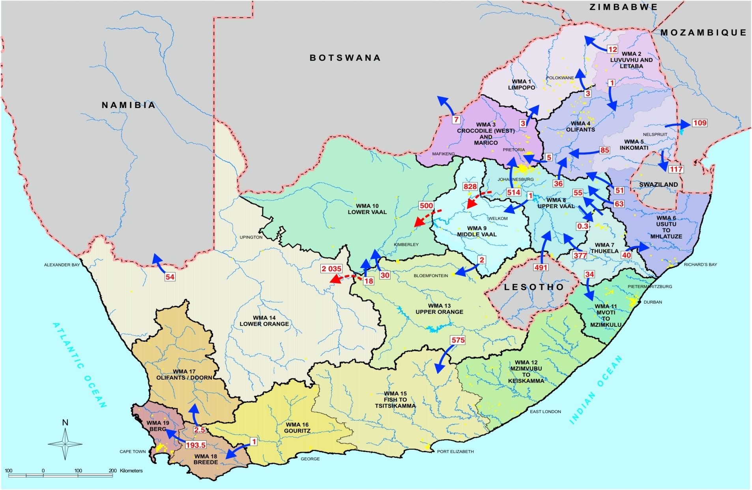
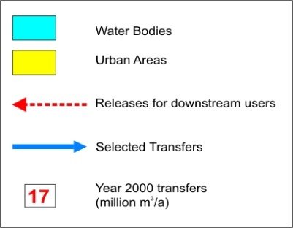
6. Inter-basin water transfers in South Africa
South Africa has several water transfers in the country that are critical for water security of water supply systems. e.g.
  Gqeberha is supplied with water that is transferred from Orange River in addition to its local resources
  Gauteng is supplied from different sub-catchments like Upper Orange, Thukela and the Vaal River
The transfers form a network of interlinked water resource systems that strengthens resilience of water supply
These transfers are being strengthened by connecting with groundwater systems
10
Notes:
Do we have a slide without the transfer arrows?
Add to slides

Slide 11
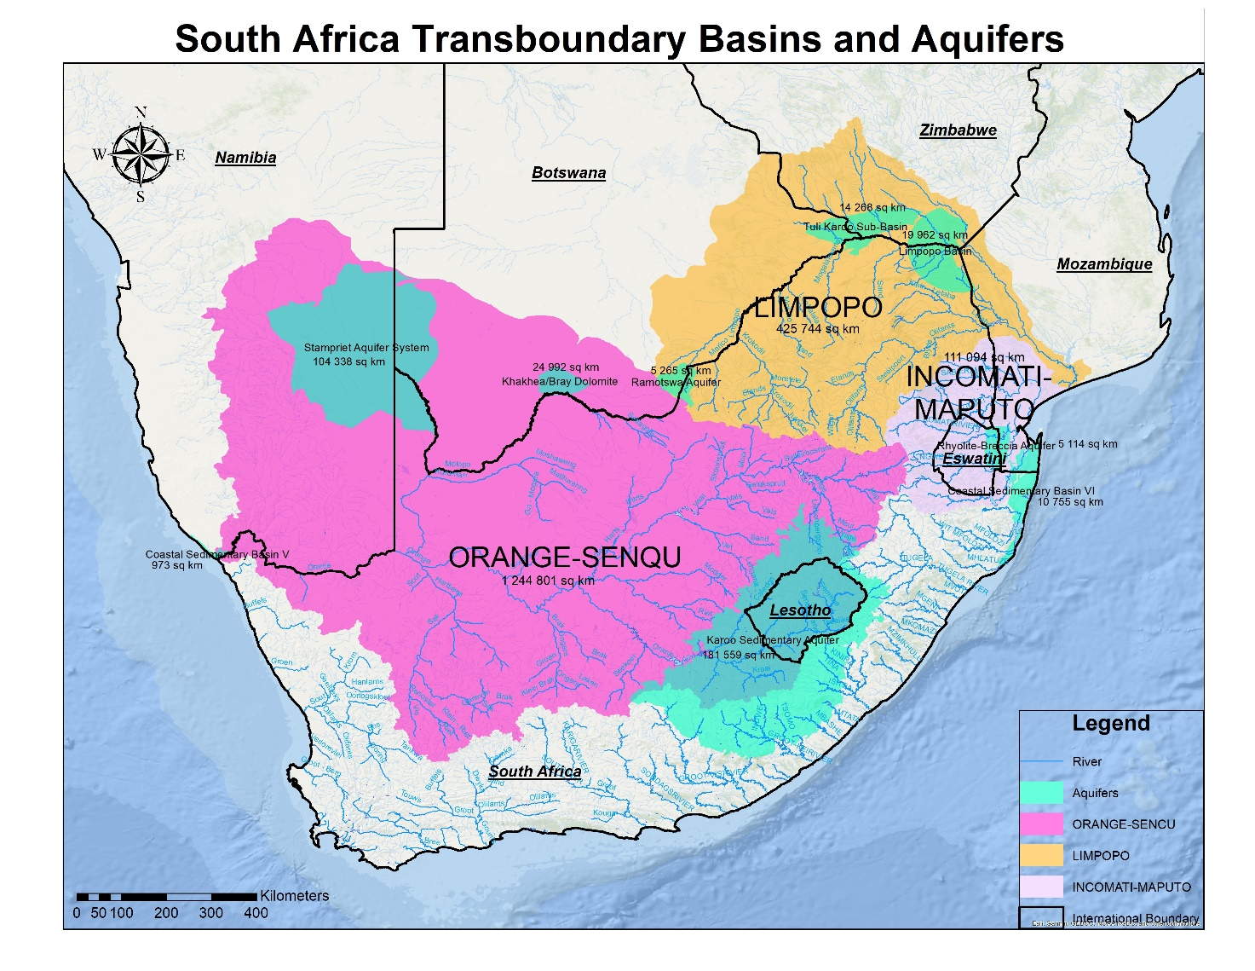
7. Water sharing and transfers to and from co-basin states
4 River basins (Limpopo, Inco-Maputo, Orange-Senqu, Umbeluzi) shared with 6 neighbouring countries
Several international transfers
  Lesotho to SA - Lesotho Highlands Water Project (LHWP)
  SA-Namibia water sharing in lower Orange River
  SA to Botswana on the Molatedi Dam Transfer
  SA-Eswatini for Pongolapoort/ Jozini Dam, and co-development of Komati Basin (Maguga and Driekoppies Dams)
Projects under planning and implementation
  Lower Orange River developments with Namibia (Noordoewer/ Vioolsdrift Dam) – Feasibility Stage
  Lesotho Botswana Water Transfer Project – Feasibility Stage
  Musina Beitbridge Integrated Water Supply Scheme with Zimbabwe – Feasibility/Design Stage
  Phase II of Lesotho Highlands Water Project – Construction Stage
11

Slide 12
8. Measures to promote desalination and water reclamation uptake
Non-conventional water sources like reuse of effluent and seawater desalination are another of pillar of water security
Seawater desalination enhances climate change resilience in coastal locations
The contribution of reuse of effluent is projected to grow from 10% to 15% and that of seawater desalination from 0.5% to 5% of the total future water sources by 2050
In order to exploit these targets for these sources, the following measures are needed;
  Policies that promote sustainable desalination practices
  Innovative financing and procurement models e.g., Independent Water Producers
  Investing in energy-efficient desalination technologies, like reverse osmosis with energy recovery systems, to reduce operational costs and environmental impact.
  Supporting research into new desalination methods and technologies
  Implementing best practices for brine disposal to minimize environmental impact,

Slide 13
9. Water quality and impacts on water security, human health and aquatic ecosystems
South Africa faces major challenges of deteriorating water quality in rivers, lakes, dams, wetlands, estuaries or the coastal marine environment, due to point and non point (diffuse) sources of pollution
Poor water quality worsens the country’s inherent water stress situation. Poor water quality reduces water availability and increases treatment costs to restore water quality or to make water suitable for use
The resultant water pollution has major impacts on human health, aquatic ecosystems and on various sectors of the economy, including agriculture, industry and tourism
Effective water quality management is a developmental issue, not simply an environmental issue, and must be addressed by all Spheres of Government, together with civil society and the private sector
The financial resources currently available for managing water quality are insufficient to meet the level of investment that is required to counteract the economic harm done by declining water quality placing an additional burden on State Resources
Water quality challenges are exacerbated by low investment in the maintenance and restoration of both ecological infrastructure and wastewater treatment works

Slide 14
10. National Water Resource Strategy-3 and the National Water and Sanitation Master Plan as implementation tool
To guide the turn-around of the water sector, the DWS is leading in developing solutions for the sector, through development and update of various strategies and plans
These strategies are consolidated in the National Water Resource Strategy-3 (NWRS-3), which is implemented through the National Water and Sanitation Master Plan (NW&SMP)
The (NW&SMP) assists government with investment planning for the development of water resources, and the water supply and sanitation services over a 10 year horizon.
The critical interventions are required to turn-around the water, including reducing water demand management, and increasing and diversifying water resource supply
Other critical interventions address the enabling environment including strengthening capacity, and funding of the water sector

Slide 15
11. National Water Resource Infrastructure
Infrastructure Type | Quantity
Large State Dams | 323
Pump-stations | 57 pump-sets
Pipe lines | 1070km
Canal Systems | 8100km
Tunnel Systems | 171km
Measuring Facilities | 3011 (weirs)
Raw water Reservoirs | 51
Operations Buildings | 2581
Asset Class | Book Value
Dams | 29 345 707 619,58
Canals | 5 625 702 819,50
Tunnels | 5 670 619 092,35
Pipelines | 6 531 727 935,85
Pump stations | 2 093 909 554,52
Buildings | 1 275 551 899,57
Reservoirs | 238 002 639,12
Roads and bridge | 302 183 961,66
Power Supply | 39 049 811,94
Water Treatment | 750 557 495,98
Boreholes | 4 664 917,39
Measuring facilities | 1 346 832 191,01
Telemetry | 120 507 681,32
Enduring Benefits | 17 215 644 175,68
Land | 7 550 389 033,25
Total Book Value:
R78 111 050 828,72
15

Slide 16
National Water Resource Infrastructure Asset Condition
CONDITION AS AT 31 MARCH 2024
78% of the national water resource infrastructure assets are in a very good, good and fair condition.
.
In the 2023/24 financial year, DWS added R296 million in value to the asset base through its maintenance and refurbishment program.
Annually, the department conduct asset condition verification to guide the maintenance planning program.

Slide 17
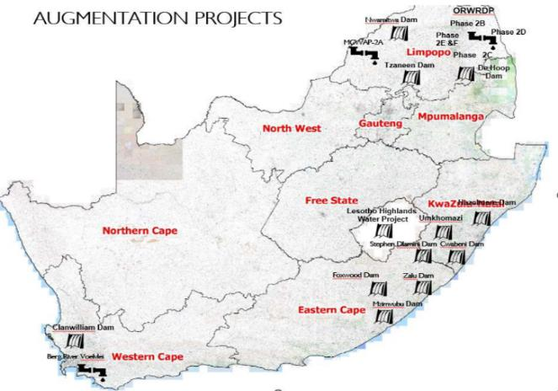
(under implementation)

Slide 18
PROJECTS FOR THE RAISING OF EXISTING DAMS
 | PROJECT NAME | PROVINCE | PROJECT DESCRIPTION | % CONSTRUCTION COMPLETE | ESTIMATED COST | CONSTRUCTION COMPLETION DATE
1. | RAISING OF HAZELMERE DAM | KWA-ZULU NATAL | Construction to raise the wall of the existing Hazelmere Dam to provide additional water to eThekwini and surrounding areas | 100 % | R 0,865 BILLION | Licence to impound issued in Oct 2024 (Housing for relocation to be completed in 2025)
2. | RAISING OF TZANEEN DAM | LIMPOPO | Construction to raise the wall of the existing Tzaneen Dam to address water shortages in Tzaneen and surrounding areas in Limpopo | 29 % | R 0,760 BILLION | 2025
3. | RAISING OF EXISTING CLANWILLIAM DAM | WESTERN CAPE | Construction to raise the wall of the existing Clanwilliam Dam to double the size of the dam to provide additional water for irrigation, domestic and industrial use to Clanwilliam and surrounding areas in the Western Cape | 16 % | R 6,8 BILLION | 2028
18

Slide 19
NEW DAMS AND ASSOCIATED WORKS
 | PROJECT | PROVINCE | PROJECT DESCRIPTION | % CONSTRUCTION COMPLETE | ESTIMATED COST | CONSTRUCT COMPLETION DATE
4. | GROOT LETABA WATER AUGMENTATION PROJECT: NWAMITWA DAM AND ASSOCIATED WORKS | LIMPOPO | Construction of Nwamita Dam on the Great Letaba River, to provide additional water for irrigation, to increase flows into the Kruger National Park, and to provide additional water for domestic and industrial use in eastern part of Limpopo | PRE-CONSTRUCTION ACTIVIES (FUNDING, DETAIL DESIGN) | R 6.06 BILLION | To be confirmed once funding has been secured
5. | MZIMVUBU WATER PROJECT: NTABELANGA DAM AND ASSOCIATED WORKS | EASTERN CAPE | Construction of Ntabelanga Dam and associated works on a tributary of the uMzimvubu River to provide additional water for irrigation and domestic use in the eastern region of the Eastern Cape | PRE-CONSTRUCTION ACTIVITIES (DETAILED DESIGN , ACCESS ROAD 89%) | R 8.1 BILLION | 2028
6. | KOONAP RIVER WATER PROJECT: FOXWOOD DAM AND ASSOCIATED WORKS | EASTERN CAPE | Construction of Foxwood Dam and associated works to provide additional water for irrigation and for the town of Adelaide in the Eastern Cape | PRE-CONSTRUCTION (FUNDING, DETAIL DESIGN) | R 2.2 BILLION | 2029
7. | LUSIKISIKI WATER AUGMENTATION PROJECT: ZALU DAM AND ASSOCIATED WORKS | EASTERN CAPE | Construction of Zalu Dam and associated works to provide additional water for the town of Lusikisiki and surrounding villages in the Eastern Cape | PRE-CONSTRUCTION (DETAIL DESIGN, FUNDING) | R 0,957 BILLION | 2029
19

Slide 20
 | PROJECT | PROVINCE | PROJECT DESCRIPTION | % CONSTRUCTION COMPLETE | COST | CONSTRUCTION COMPLETION DATE
8. | ALGOA WATER SUPPLY SYSTEM: COERNEY BALANCING DAM PROJECT | EASTERN CAPE | Construction of Coerney Balancing Dam and associated works to improve water security for the Nelson Mandela Bay Metropolitan area. | PRE-CONSTRUCTION (DETAIL DESIGN) | R 0,612 BILLION | 2029
9 | uMKHOMAZI WATER PROJECT ((TCTA) | KWA-ZULU NATAL | Construction of uMkhomazi Dam and associated works to provide urgently needed additional water to eThekwini, uMgungundlovu and surrounding areas in KwaZulu Natal | PRE-CONSTRUCTION ( FUNDING, DETAILED DESIGN) | R23 BILLION | 2032
10. | BERG RIVER VOELVLEI AUGMENTATION SCHEME (BRVAS) (TCTA) | WESTERN CAPE | Construction of infrastructure to abstract water from the Berg River and convey it to the existing Voëlvlei Dam to increase the supply of water to the City of Cape Town and surrounding areas | PRE-CONSTRUCTION (FUNDING, DETAIL DESIGN) | R1,2 BILLION | 2028
11. | PHSASE 2 OF MOKOLO CROCODILE (WEST) WATER AUGMENTATION PROJECT (MCWAP PHASE 2) TCTA | LIMPOPO | Construction of a new water transfer pipeline and associated works from the Crocodile West River to the Lephalale area of Limpopo to augment water supply to the recently completed Medupi Power Station, Lephalale Town and the existing Matimba Power station | PRE-CONSTRUCTION (FUNDING, DETAIL DESIGN) | R 12, 4 BILLION | 2029
20

Slide 21
 | PROJECT | PROVINCE | PROJECT DESCRIPTION | % CONSTRUCTION COMPLETE | ESTIMATED COST | CONSTRUCTION COMPLETION DATE
12 | OLIFANTS MANAGEMENT MODEL (LEBALELO) | LIMPOPO | Development of the bulk water distribution system from the recently completed De Hoop Dam to supply communities and mines in Sekhukhune and Mogalakwena in Limpopo by 2030. | PRE-CONSTRUCTION ACTIVITIES (PLANNING AND DESIGN, FUNDING) | R 25 BILLION | 2028
13. | uMZIMKHULU WATER PROJECT: CWABENI OFF-CHANNEL STORAGE DAM (UNNGENI-UTHUKELA) | KWA-ZULU NATAL | Construction of Cwabeni off-channel storage dam to provide additional water to Port Shepstone and surrounding areas in KwaZulu Natal | PRE-CONSTRUCTION (FUNDING, DETAIL DESIGN) | R1,8 BILLION | 2030
14. | STEPHEN DLAMINI DAM AND ASSOCIATED WORKS (UMNGENI-UTHUKELA) | KWA ZULU NATAL | Construction of Stephen Dlamini Dam and associated works to provide sustainable water supplies to the town of Bulwer and surrounding peri-urban and rural communities in KwaZulu Natal | PRE-CONSTRUCTION (FUNDING, DETAIL DESIGN) | R0,795 BILLION | 2030
21

Slide 22
 | PROJECT | PROVINCE | PROJECT DESCRIPTION | % CONSTRUCTION COMPLETE | ESTIMATED COST | CONSTRUCTION COMPLETION DATE
15. | Phase 2 of Lesotho Highlands Water Project (TCTA) | International (Lesotho) | Construction of Polihali Dam, Tunnel to connect to Katse Dam and Associated Infrastructure. This project will augment the Integrated Vaal River System which supplies Gauteng and surrounding areas | 25 % Complete | ~ R42 Billion | 2032
 |  |  |  | TOTAL | ~R132 Billion
Notes:
1. More than 50% of the funding is sourced off-budget.
2. Establishment of the NWRIA will enable more finance to be raised on the markets, using the NWRIAs balance sheet and revenue streams
22

Slide 23
12. Recommendations
Prioritise Water Conservation and Water Demand Management
Accelerate the surface water development program to increase yield
Diversify the water mix by increasing use of groundwater and non-conventional water sources like reuse effluent (10% to 15%) and desalination (0.5% to 5%)
Growth in irrigation water requirements must come from savings within the sector
Enhance collection of water revenues to finance new water developments and rehabilitation of aging water infrastructure
Implement measures to ensure resilience of water infrastructure and systems to climate change
Prioritise measures aimed at improving water quality of both groundwater and surface water
Some R132 billion will be required for water resource development projects implement the projects
Take note of the progress and milestones for the establishment of the NWRIA

Slide 24
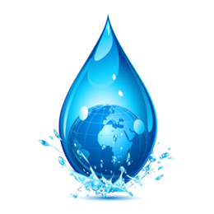
THANK YOU

